Slide 1
FUNDAMENTAL MARKETING CONCEPTS
Core Concepts

Slide 2
NEEDS, WANTS, AND DEMANDS
Needs are the basic human requirements. People need food, air, water, clothing, and shelter to survive. People also have strong needs for recreation, education, and entertainment.
These needs become wants when they are directed to specific objects that might satisfy the need.
E.g. An American needs food but may want a hamburger, French fries, and a soft drink. A person in Mauritius needs food but may want a mango, rice, lentils, and beans. Wants are shaped by one's society.
Demands are wants for specific products backed by an ability to pay. Many people want a Mercedes; only a few are willing and able to buy one.

Slide 3
TARGET MARKETS, POSITIONING, AND SEGMENTATION
Marketers identify and profile distinct groups of buyers . The marketer then decides which segments present the greatest opportunity—which are its target markets.
Scorpio, a sports-utility vehicle (SUV) launched in India by Mahindra & Mahindra in 2002, is designed for people who prefer a sturdy vehicle that offers luxury and comfort. Scorpio, therefore, is positioned as a vehicle that offers the luxury of a car and the thrill of an SUV.

Slide 4
OFFERINGS AND BRANDS
Companies address needs by putting forth a value proposition which is a set of benefits they offer to customers to satisfy their needs.
A brand is an offering from a known source. A brand name carries many associations in the minds of people. These associations make up the brand image.

Slide 5
VALUE SATISFACTION
Offerings will be successful if it delivers value and satisfaction to the target buyer.
Value reflects the perceived tangible and intangible benefits and costs to customers. Value can be seen as primarily a combination of quality, service, and price (qsp), called the "customer value triad." Value increases with quality and service and decreases with price, although other factors can also play an important role.

Slide 6
Contd…..
Value is a central marketing concept. Marketing can be seen as the identification, creation, communication, delivery, and monitoring of customer value.
Satisfaction reflects a person's comparative judgments resulting from a product's perceived performance in relation to his or her expectations. If the performance matches the expectations, the cus­tomer is satisfied. If the performance exceeds expectations, the customer is highly satisfied or delighted.

Slide 7
MARKETTING CHANNELS
The marketer uses three kinds of marketting channels.
Communication channels deliver and receive messages from target buyers, and include newspapers, magazines, radio, television, mail, telephone, etc.
The marketer uses distribution channels to display, sell, or deliver the physical product or service(s) to the buyer or user. They include distributors, wholesalers, retailers, and agents.
The marketer also uses service channels to carry out transactions with potential buyers. Service channels include warehouses, transportation companies, banks, and insurance comanies that facilitate transactions.

Slide 8
SUPPLY CHAIN
The marketing channels connect the marketer to the target buyers, the supply chain describes a longer channel stretching from raw materials to components to final products that are carried to final buyers.

Slide 9
COMPETITION
Competition includes all the actual and potential rival offerings and substitutes that a buyer might consider. Suppose an automobile company is planning to buy steel for its cars. There are several possible levels of competitors. The car manufacturer can buy steel from Tata Steel or SAIL or import from abroad; or buy aluminum for certain parts to lighten the car's weight; or buy engineered plastics for bumpers instead of steel.

Slide 10
MARKETTING ENVIORNMENT
The marketing environment consists of the task environ­ment and the broad environment.
The task environment includes the immediate players involved in producing, distributing, and promoting the offering. The main actors are the company suppliers, distributors, dealers, and the target customers. Included in the supplier group are material suppliers and service suppliers such as marketing research agencies, advertising agencies, banking and insurance companies, transportation companies, and telecommunications companies. Included with distributors and dealers are agents, brokers, manufacturer representatives, and others who facilitate finding and selling to customers.

Slide 11
Contd….
MARKETTING ENVIORNMENT
The broad environment consists of six components: demographic environment, economic environment, physical environment, technological environment, political-legal environment, and social-cultural environment.

Slide 12
MARKETTING PLANNING
The marketing planning process consists of analyzing marketing opportunities; selecting target markets; designing marketing strategies; developing marketing programs; and managing the marketing effort.

Slide 13
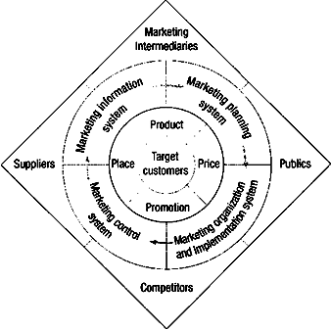
process of marketing

Slide 14
MARKETING RESEARCH

Slide 15
MARKETING RESEARCH
In addition to monitoring a challenging and changing marketing environment, marketers also require information to help them interpret past performance as well as plan future activities.
Timely, accurate, and actionable information on consumers, competition, and their brands, as they require to make best possible tactical decisions in the short run and strategic decisions in the long run.

Slide 16
The Marketing Research System
Marketing managers often make formal marketing studies of specific problems and opportunities, which include the study on :
A market survey,
A product-preference test,
A sales forecast by region, Or
An advertising evaluation.

Slide 17
Definition: Marketing Research
Marketing research is the systematic collection, analysis, design, and reporting of data and findings relevant to a specific marketing situation of a company.

Slide 18
The Marketing Research Process
Effective marketing research involves the six steps.
Step 1: Define the Problem & the Research Objectives.
Step 2: Develop the Research Plan.
Step 3: Collect the Information.
Step 4: Analyze the Information.
Step 5: Present the Findings.
Step 6: Make the Decision.

Slide 19
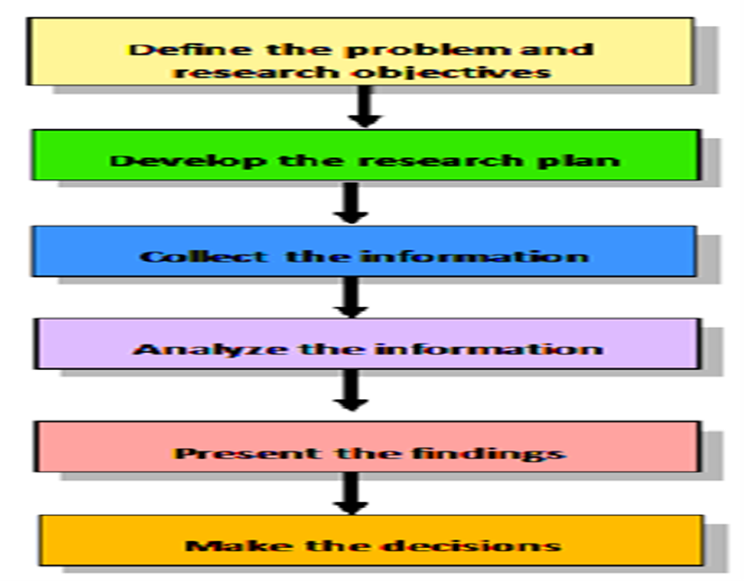


Slide 20
Step 1:
Define the Problem and the Research Objectives
Problems should not be defined either too broadly or too narrowly.
A very broad or vague definition leads to excessive wastage of resources.
Too narrow a definition leads to inadequate data or information for to take an effective decision.
To define the problem appropriately:
  What is to be researched (the content, the scope) and
  Why is it to be researched (the decisions that are to be made)

Slide 21
Step 2:
Develop the Research Plan
Marketing research requires developing the most efficient plan for gathering the needed information.
This involves decisions on the :
Data sources,
Research approaches,
Research instruments,
Sampling plan, and
Contact methods.

Slide 22
2.1 DATA SOURCES
The researcher can gather secondary data, primary data, or both.
Secondary data are data that were collected for another purpose and already exist some where.
Primary data are data freshly gathered for a specific purpose or for a specific research project.

Slide 23
2.2 RESEARCH APPROACHES
Primary data can be collected in five ways:
1) Through observation Research
2) Focus groups Research
3) Surveys Research
4) Behavioral data, and
5) Experimental Research

Slide 24
1)Observational Research:
Fresh data can be gathered by observing.
2) Focus Group Research:
A focus group is a gathering of six to ten people who are invited to spend a few hours with a skilled moderator to discuss a product, service, organization or other marketing entity. The moderator on the issue, and skilled in group dynamics. Participants are offered with gifts for attending, the meeting & is typically held in pleasant surroundings.

Slide 25
3) Survey Research:
Surveys are best suited for descriptive research. Companies undertake surveys to learn about people's knowledge, beliefs, preferences and satisfaction. It requires development of a survey instrument, usually a questionnaire, which the respondents are asked to fill up.

Slide 26
4) Behavioral Data:
Customers' actual purchases reflect preferences and are normally more reliable than memory-based statements made in surveys. As per Observations many high-income group customers do not buy expensive consumer goods, while some low-income consumers end up buying expensive products, contrary to stated preferences in surveys.
5) Experimental Research: is scientifically valid, which search & capture cause-and-effect relationships, with competing explanations of the observed findings.

Slide 27
2.3 RESEARCH INSTRUMENTS
Marketing researchers have a choice of three main research instruments in collecting primary data:
1) Questionnaires
2) Qualitative measures, and
3) Mechanical devices.

Slide 28
Questionnaires
A questionnaire consists of a set of questions presented to respondents.
Is more flexible
Questionnaire is the most common instrument used to collect primary data.

Slide 29
Qualitative Measures
Qualitative research techniques are relatively unstructured measurement approaches with a range of possible responses, which are creative means of ascertaining consumer perceptions.
It includes various techniques to learn about the customer experiences & preferences to know more about the customers.
Eg: Depth Interviews-interview is conducted one-on-one, and lasts between 30 and 60 minutes.
Focus Groups an interactive group discussion led by a moderator.
Projective Techniques : such as word association, sentence completion, story completion, cartoon tests etc..

Slide 30
Seven techniques employed for understanding the customer experience are :
Shadowing—observing people using products, shopping etc.
Behavior mapping— photographing people within a space over two or three days.
Consumer journey—keeping track of all the interactions a consumer has with a product, service, or space.
Extreme user interviews—talking to people who really know about a product or service and evaluating their experience using it.
Storytelling— prompting people to tell personal stories about their consumer experiences.
Unfocus groups—interviewing a diverse group of people.

Slide 31
Mechanical Devices
Mechanical devices are occasionally used in marketing research. For example, galvanometers can measure the interest or emotions aroused by exposure to a specific ad or picture.
Eye cameras study respondents' eye movements to see where their eyes land first, how long they linger on a given item, and so on.
Recent years technology devices like skin sensors, brain wave scanners, and full body scanners are being used to get consumer responses.

Slide 32
2.4 SAMPLING PLAN
After deciding on the research approach and instruments, the marketing researcher must design a sampling plan.
The three decisions are:
Sampling unit: Who is to be surveyed?
Sample size: How many people should be surveyed?
Sampling procedure: How should the respondents be chosen?

Slide 33
2.5 CONTACT METHODS
Once the sampling plan is determined, the marketing researcher must decide how the subject should be contacted:
Mail
Telephone
Personal, or
Online interview.

Slide 34
Step 3:
Collect the Information
The data collection phase of marketing research is the most expensive and the most prone to error.
Four major problems are:
Some respondents not available at home and must be contacted again or replaced.
Respondents may refuse to cooperate.
Biased or dishonest answers
Due to biased or dishonest. Getting the right respondents is critical.

Slide 35
Step 4:
Analyze the Information
The next-to-last step in the process is to extract findings from the collected data.
The researcher tabulates the data and develops frequency distributions.
Averages and measures of dispersion are computed for the major variables. The researcher will also apply some advanced statistical techniques and decision models in the hope of discovering additional findings.

Slide 36
Step 5:
Present the Findings
As the last step, the researcher presents the findings. The researcher should present findings that are relevant to the major marketing decisions facing management.

Slide 37
Step 6:
Make the Decision
Research findings provide additional information and insights to the managers.
Marketing decision support system can be used to help marketing managers make better decisions, (MDSS) is defined as a coordinated collection of data, systems, tools, and techniques with supporting software and hardware by which an organization gathers and interprets relevant information from business and environment and turns it into a basis for marketing action.

Slide 38
Barriers to the Use of Marketing Research
A narrow conception of the research.
Uneven caliber of researchers.
Poor framing of the problem.
Late and occasionally erroneous findings.
Personality and presentational differences.

